Slide 1
Do Now
Complete the test reflection to turn in.

Slide 2
Day 1

Slide 3
Unit 2 Exam: Research & Social
1st Period
Range: 26-97
Mean: 82
Median: 86
Mode: (mult)
Last Year
5th Period
Range: 29-95
Mean: 70
Median: 70
Mode: 78
2nd Period
Range: 13-100
Mean: 71
Median: 72
Mode: 68
6th Period
Range: 51-100
Mean: 76
Median: 73
Mode: 89

Slide 4
Introduction Atkinson-Shiffrin Three-Stage Model
Encoding
Storage
Retrieval

Slide 5
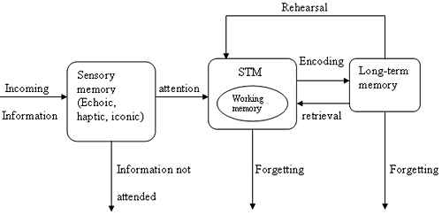
Modified Three-stage Processing Model of Memory

Slide 6
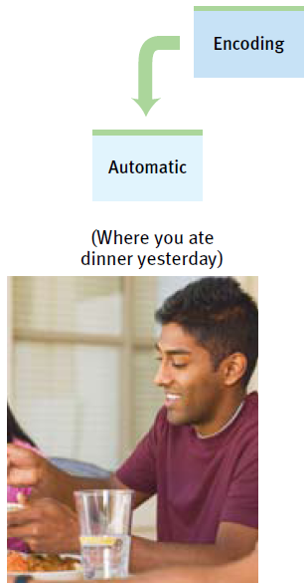
Encoding: Getting Information In How We Encode
Automatic Processing
Parallel processing
Automatic processing
Space
Time
Frequency
Well-learned information

Slide 7
Automatic Processing Read the Poem
Spring is the
The most beautiful
Time of the year

Slide 8
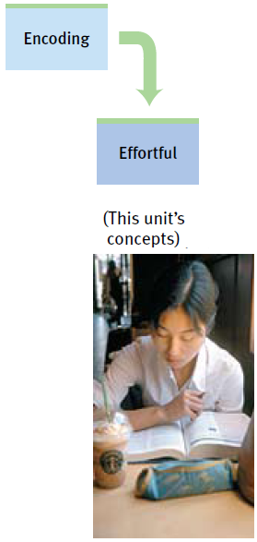
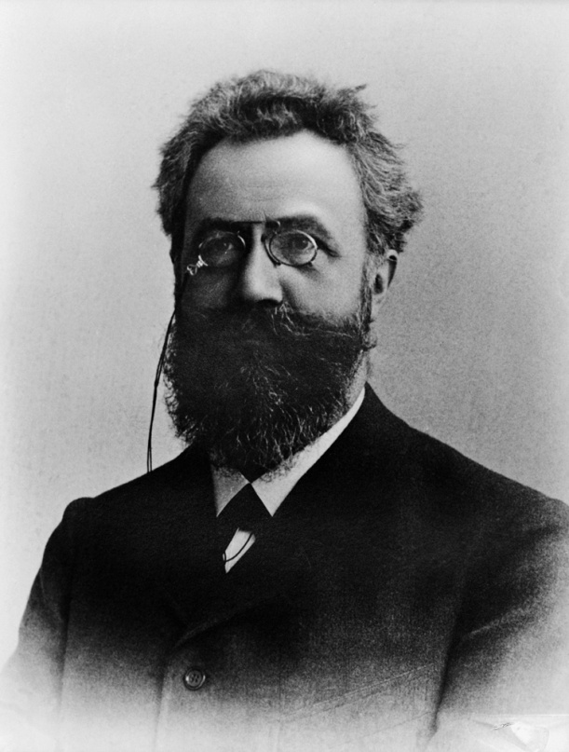
Encoding: Getting Information In How We Encode
Effortful Processing
Rehearsal (conscious repetition)
Ebbinghaus curve
(Color Question)

Slide 9
The 12 Days of Christmas
On your paper, write the numbers 1-12.
Next to each number, write the gift that was given on that day in the song “The 12 days of Christmas”
Do this WITHOUT talking to a neighbor.
The song starts – “On the first day of Christmas my true love gave to me…”

Slide 10
A partridge in a pear tree
2 Turtle Doves
3 French Hens
4 Calling Birds
5 Gold Rings
6 Geese a-Laying
7 Swans a-Swimming
8 Maids a-Milking
9 Ladies Dancing
10 Lords a-Leaping
11 Pipers Piping
12 Drummers Drumming

Slide 11
Rehearsal & Memory
Which gifts were easiest to remember?
What does this indicate about the effect of rehearsal on memory?

Slide 12
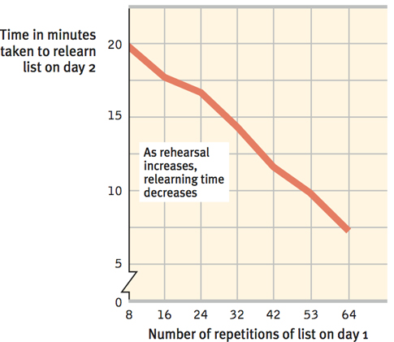
Encoding: Getting Information In How We Encode
Re-Learning Effect
How does this relate to Level-ups?

Slide 13
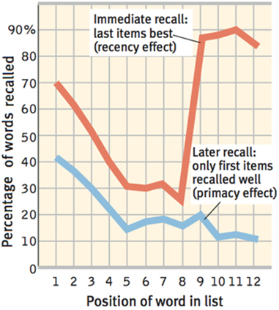
Encoding: Getting Information In How We Encode
Serial position effect
Recency effect
Primacy effect

Slide 14
Encoding: Getting Information In How We Encode
Overlearning
Spacing effect
Massed practice
Distributed practice
Testing effect

Slide 15
Day 2

Slide 16
Test Corrections
Look over your test and the score printout.
What questions do you have?
Review directions for test corrections.
Review Questions:
29, 1, 24, 10, 26
Any additional questions based on the test?

Slide 17
Encoding: Meaning & Memory
Listen to the following story:
CLOSE YOUR EYES!

Slide 18
The context for the story is flying a kite

Slide 19
Encoding & Memory
Read the directions on your wkst. THEN rate each sentence as I read it aloud. DO NOT show your paper to anyone else.

Slide 20
Encoding: Getting Information In What We Encode
Levels of Processing
Visual encoding
Acoustic encoding
Semantic encoding
Self-reference effect

Slide 21
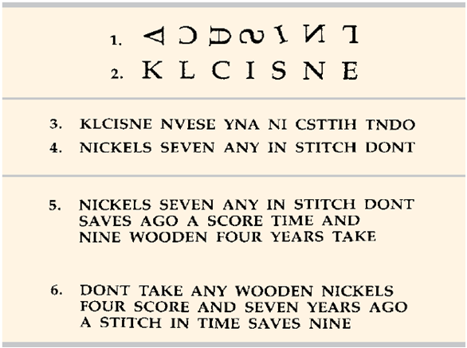
Encoding: Getting Information In What We Encode
Organizing Information for Encoding
Chunking
acronym

Slide 22
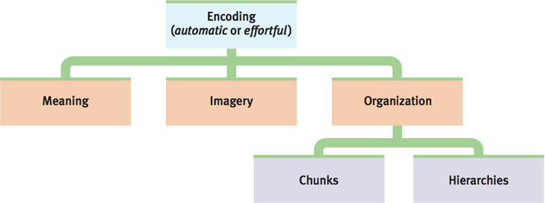
Encoding: Getting Information In What We Encode
Organizing Information for Encoding
Hierarchies

Slide 23
Modified Three-stage Processing Model of Memory

Slide 24
Storage: Retaining Information
Sensory Memory
We store information in sensory memory for a fraction of a second.
Iconic memory
Flashlight afterimage, waving hand
Echoic memory
In class, what happens when you are distracted and are called on to give an answer?

Slide 25
Storage: Retaining Information
Short-Term/Working Memory
We store information in short-term memory for only a few seconds.
Listen as I read the following numbers. I will start with “ready.” When I say “recall,” write down as many numbers as you can in the correct sequence.
2nd trial with chunking
Now, look at the images I present. I will count to three, show the image, then say “write.” When directed, write down the number of dots that were on the page.
Impact of chunking???

Slide 26
Storage: Retaining Information Working/Short-Term Memory
Magic number Seven
Plus or minus 2

Slide 27
Storage: Retaining Information
Long-Term Memory
Unlimited nature of long-term memory
We use the encoding strategies we learned last week to move information from sensory memory to short-term memory and from short-term memory to long-term memory.

Slide 28
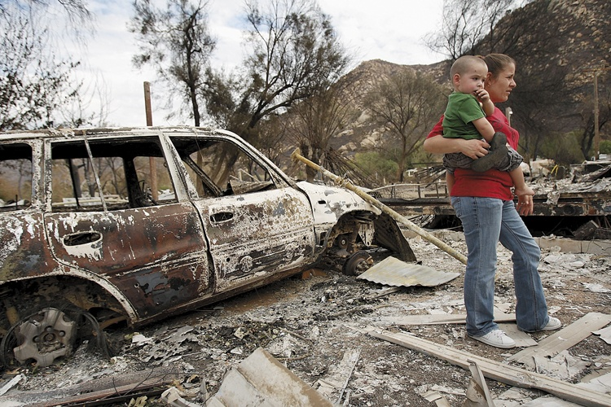
Storage: Retaining Information Storing Memories in the Brain
Stress Hormones and Memory
Emotions and memories
Flashbulb memory

Slide 29
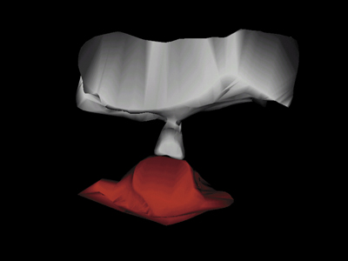
Storage: Retaining Information Storing Memories in the Brain
Synaptic Changes
Memory trace
Long-term potentiation (LTP)
Memory boosting drugs
Glutamate (neurotransmitter)

Slide 30
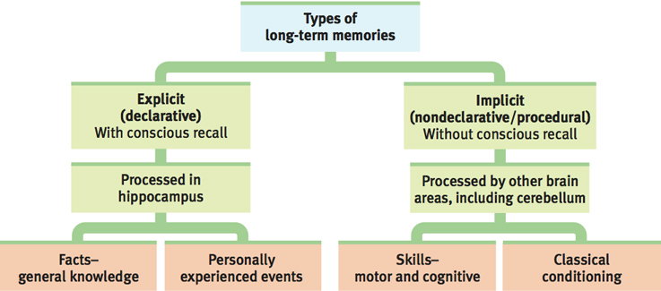
Storage: Retaining Information Storing Memories in the Brain

Slide 31
REMEMBER – Time spend studying does not necessarily equal QUALITY TIME spent studying!
USE what you are learning in this chapter to help you better study and prepare for your tests.
At first this will require more effort but with time, these techniques will become more and more automatic!
WRITE: What are 1-3 things you will use from what we have discussed as you study for level-up quizzes? BE SPECIFIC!

Slide 32
Day 3

Slide 33
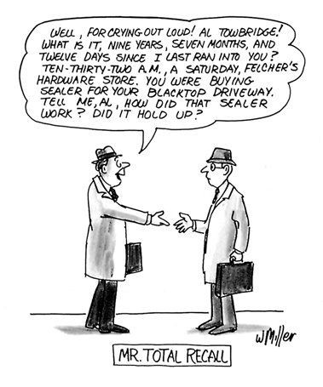
Retrieval: Getting Information Out
Recall
Recognition
Relearning

Slide 34
Handout 7a
Take out a blank piece of paper. Complete handout 7a, following the directions (2 min)
When you are done, turn the paper and complete 7b

Slide 35
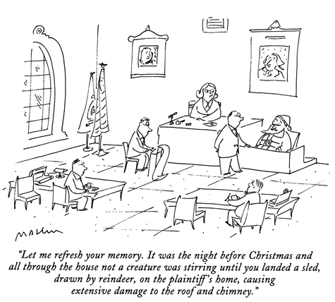
Retrieval: Getting Information Out Retrieval Cues
Retrieval cues
Mnemonic devices
Priming

Slide 36
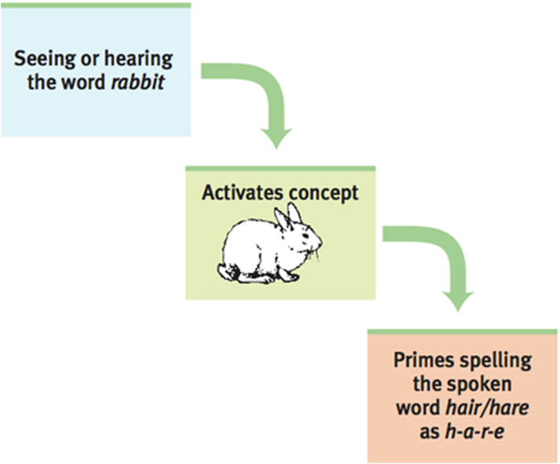
Priming

Slide 37
Listen to the following list:

Slide 38
Rest

Slide 39
Snore

Slide 40
Sound

Slide 41
Tired

Slide 42
Bed

Slide 43
Comfort

Slide 44
Awake

Slide 45
Eat

Slide 46
Wake

Slide 47
Dream

Slide 48
Slumber

Slide 49
Night

Slide 50
Write down as many words as you can remember

Slide 51
Raise your hand if you remember the word ardvark.

Slide 52
Raise your hand if you remember the word sleep.

Slide 53
Retrieval: Getting Information Out Context Effects & Priming
Context effects
Déjà vu

Slide 54
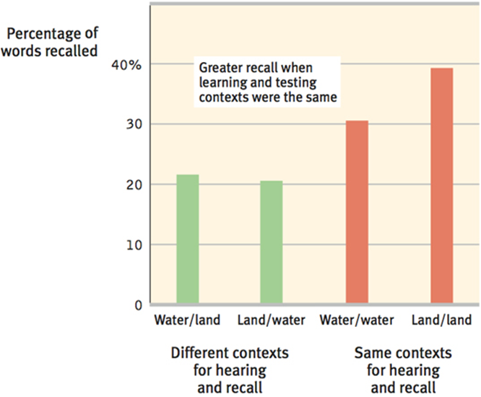
Retrieval: Getting Information Out Context Effects & Retrieval Cues

Slide 55
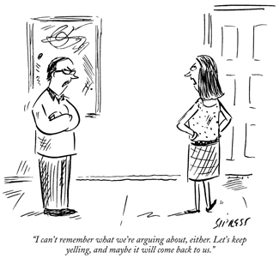
Retrieval: Getting Information Out Moods and Memories
State dependent memory
Mood congruent memory

Slide 56
Day 4

Slide 57
Forgetting

Slide 58
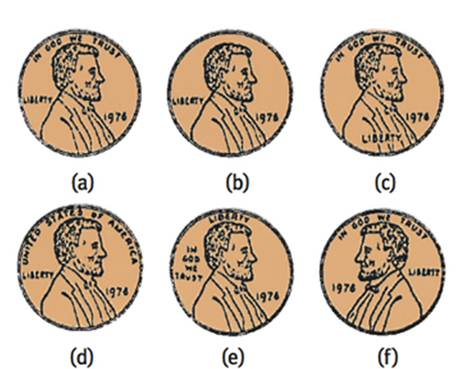
Encoding Failure
Encoding failure – which is correct?

Slide 59
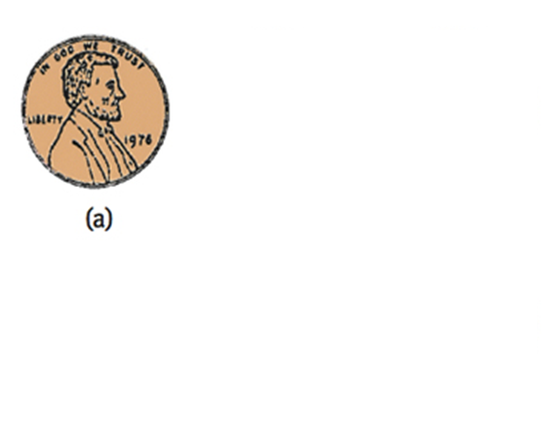
Encoding Failure
Encoding failure

Slide 60
Encoding Failure
Answer the following questions:

Slide 61
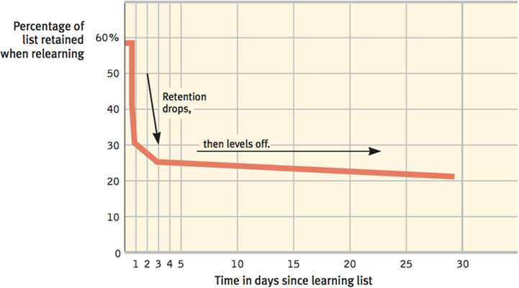
Storage Decay
Storage decay
Ebbinghaus curve

Slide 62
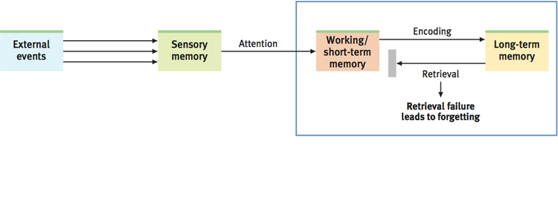
Retrieval Failure

Slide 63
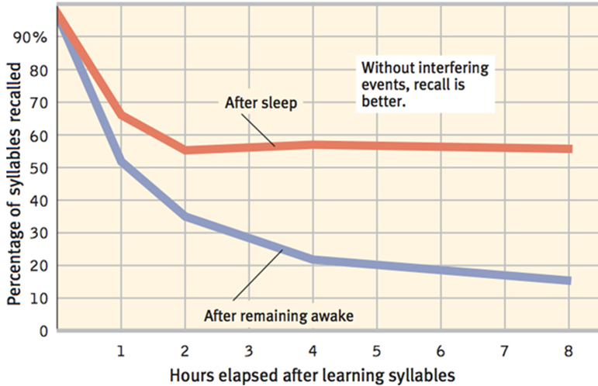
Retrieval Failure Interference
Proactive interference (forward acting)
Retroactive interference (backward-acting)

Slide 64
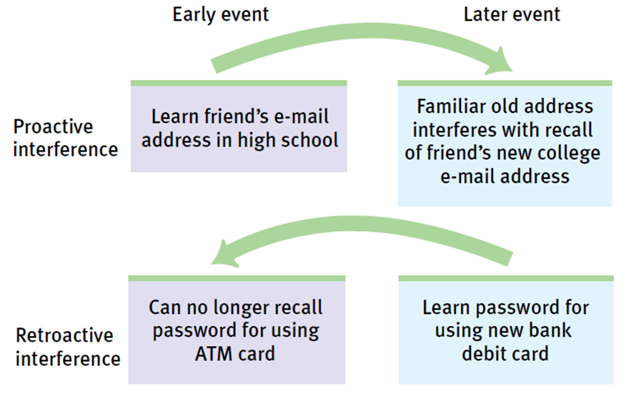
Retrieval Failure Interference PORN

Slide 65
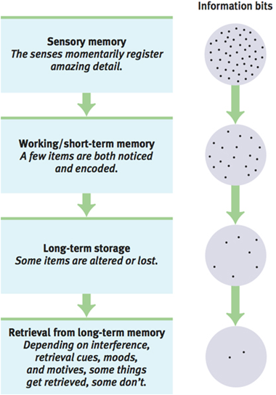
Retrieval Failure Motivated Forgetting
Self-serving personal histories
Repression

Slide 66
Create a poster showing Schacter’s 7 Sins of Memory. Include an image & description/mnemonic to help you remember each. You can collaborate with your group, but make sure each person in the group is working on a different “sin.” I will post the best ones!
Sins of Forgetting
Absent-mindedness – inattention to details leads to encoding failure
Transience – storage decay over time
Blocking – inability to access stored information (leads to tip-of-the tongue phenomenon)
Sins of distortion
Misattribution – confusing the source of information
Suggestibility – lingering affects of misinformation
Bias – belief-colored recolections
Sin of intrusion
Persistence – unwanted memories

Slide 67
Memory Construction

Slide 68
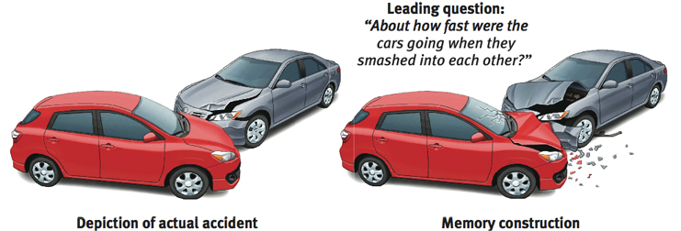
Misinformation and Imagination Effects
Loftus memory studies
Misinformation effect

Slide 69
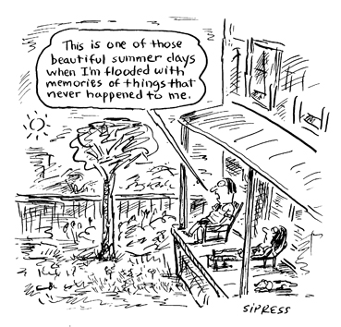
Source Amnesia
Source amnesia (source misattribution)

Slide 70
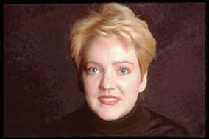
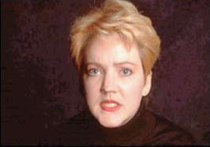
Discerning True and False Memories
Memory studies
Eye witness testimony

Slide 71
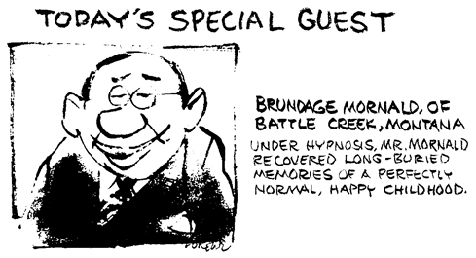
Children’s Eyewitness Recall
Children’s memories of abuse
Suggestibility

Slide 72
Repressed or Constructed Memories of Abuse?
Areas of agreement
Sexual abuse happens
Injustice happens
Forgetting happens
Recovered memories are incomplete
Memories before 3 years are unreliable
Hypnotic memories are unreliable
Memories can be emotionally upsetting

Slide 73
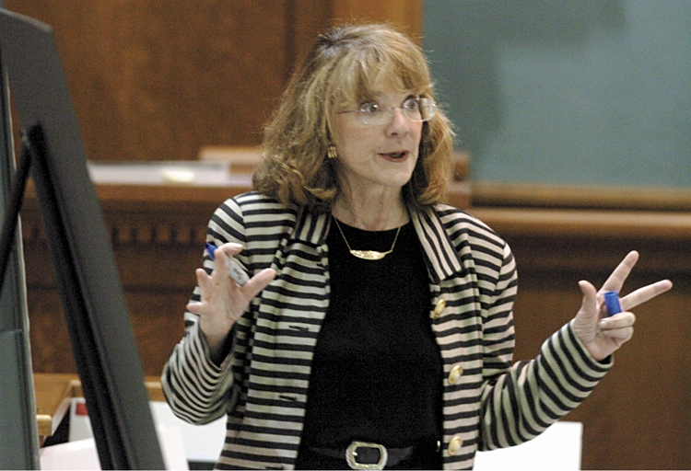
Repressed or Constructed Memories of Abuse?
Loftus studies with children

Slide 74
Improving Memory

Slide 75
Improving Memory Techniques
Study repeatedly
Make the material meaningful
Activate retrieval cues
Use mnemonic devices
Minimize interference
Sleep more
Test your own knowledge, both to rehearse it and to help determine what you do not yet know

Slide 76
Proper Flashcard Use
Look only at term and say complete definition in head/out loud (or vice-versa)
Definition does not need to be word-for-word what is on the card, but it should cover ALL key points.
If correct, put card in the “KNOW IT” pile. If incorrect (even partially) put in the “DON’T KNOW” pile.
If you don’t know a term, pause to REHEARSE the correct definition. Even better, create an image or mnemonic to help you remember the word next time.
When you get to the bottom of your stack, pick up the “DON’T KNOW” pile and repeat, adding any terms you now know to the “KNOW IT” pile.
When all words are in the “KNOW IT” pile, SHUFFLE and go through them all again to be sure you really know the words.
Check again every few days!!!

Slide 77
Concept Map
Create a concept map using AT LEAST 10 terms from unit 7A. Write a short description explaining each connection you make.

Slide 78
The End

Slide 79
Teacher Information
Types of Files
This presentation has been saved as a “basic” Powerpoint file. While this file format placed a few limitations on the presentation, it insured the file would be compatible with the many versions of Powerpoint teachers use. To add functionality to the presentation, teachers may want to save the file for their specific version of Powerpoint.
Animation
Once again, to insure compatibility with all versions of Powerpoint, none of the slides are animated. To increase student interest, it is suggested teachers animate the slides wherever possible.
Adding slides to this presentation
Teachers are encouraged to adapt this presentation to their personal teaching style. To help keep a sense of continuity, blank slides which can be copied and pasted to a specific location in the presentation follow this “Teacher Information” section.

Slide 80
Teacher Information
Hyperlink Slides - This presentation contain two types of hyperlinks. Hyperlinks can be identified by the text being underlined and a different color (usually purple).
Unit subsections hyperlinks: Immediately after the unit title slide, a page (slide #3) can be found listing all of the unit’s subsections. While in slide show mode, clicking on any of these hyperlinks will take the user directly to the beginning of that subsection. This allows teachers quick access to each subsection.
Bold print term hyperlinks: Every bold print term from the unit is included in this presentation as a hyperlink. While in slide show mode, clicking on any of the hyperlinks will take the user to a slide containing the formal definition of the term. Clicking on the “arrow” in the bottom left corner of the definition slide will take the user back to the original point in the presentation.
These hyperlinks were included for teachers who want students to see or copy down the exact definition as stated in the text. Most teachers prefer the definitions not be included to prevent students from only “copying down what is on the screen” and not actively listening to the presentation.
For teachers who continually use the Bold Print Term Hyperlinks option, please contact the author using the email address on the next slide to learn a technique to expedite the returning to the original point in the presentation.

Slide 81
Teacher Information
Continuity slides
Throughout this presentation there are slides, usually of graphics or tables, that build on one another. These are included for three purposes.
By presenting information in small chunks, students will find it easier to process and remember the concepts.
By continually changing slides, students will stay interested in the presentation.
To facilitate class discussion and critical thinking. Students should be encouraged to think about “what might come next” in the series of slides.
Please feel free to contact me at kkorek@germantown.k12.wi.us with any questions, concerns, suggestions, etc. regarding these presentations.
Kent Korek
Germantown High School
Germantown, WI 53022
262-253-3400
kkorek@germantown.k12.wi.us

Slide 82
Division title (green print) subdivision title (blue print)
xxx
xxx
xxx

Slide 83
Division title (green print) subdivision title (blue print)
Use this slide to add a table, chart, clip art, picture, diagram, or video clip. Delete this box when finished

Slide 84
Definition Slide
= add definition here

Slide 85
Definition Slides

Slide 86
Memory
= the persistence of learning over time through the storage and retrieval of information.

Slide 87
Encoding
= the processing of information into the memory systems – for example, by extracting meaning

Slide 88
Storage
= the retention of encoded information over time.

Slide 89
Retrieval
= the process of getting information out of memory storage.

Slide 90
Sensory Memory
= the immediate, very brief recording of sensory information in the memory system.

Slide 91
Short-term Memory
= activated memory that holds a few items briefly, such as the seven digits of a phone number while dialing before the information is stored or forgotten.

Slide 92
Long-term Memory
= the relatively permanent and limitless storehouse of the memory system. Includes knowledge, skills, and experiences.

Slide 93
Working Memory
= a newer understanding of short-term memory that focuses on conscious, active processing of incoming auditory and visual-spatial information, and of information retrieved from long-term memory.

Slide 94
Parallel Processing
= the processing of many aspects of a problem simultaneously; the brain’s natural mode of information processing for many functions. Contrasts with the step-by-step (serial) processing of most computers and of conscious problem solving.

Slide 95
Automatic Processing
= unconscious encoding of incidental information, such as space, time and frequency, and of well-learned information, such as word meanings.

Slide 96
Effortful Processing
= encoding that requires attention and conscious effort.

Slide 97
Rehearsal
= the conscious repetition of information, either to maintain it in consciousness or to encode it for storage.

Slide 98
Spacing Effect
= the tendency for distributed study or practice to yield better long-term retention than is achieved through massed study or practice.

Slide 99
Serial Position Effect
= our tendency to recall best the last and first items in a list.

Slide 100
Visual Encoding
= the encoding of picture images.

Slide 101
Acoustic Encoding
= the encoding of sound, especially the sound of words.

Slide 102
Semantic Encoding
= the encoding of meaning, including the meaning of words.

Slide 103
Imagery
= mental pictures; a powerful aid to effortful processing, especially when combined with semantic encoding.

Slide 104
Mnemonics
= memory aids, especially those techniques that use vivid imagery and organizational devices.

Slide 105
Chunking
= organizing items into familiar, manageable units; often occurs automatically.

Slide 106
Iconic Memory
= a momentary sensory memory of visual stimuli; a photographic or picture-image memory lasting no more than a few tenths of a second.

Slide 107
Echoic Memory
= a momentary sensory memory of auditory stimuli; if attention is elsewhere, sounds and words can still be recalled within 3 or 4 seconds.

Slide 108
Long-term Potentiation (LTP)
= an increase in a synapse’s firing potential after brief, rapid stimulation. Believed to be a neural basis for learning and memory.

Slide 109
Flashbulb Memory
= a clear memory of an emotionally significant moment or event.

Slide 110
Amnesia
= loss of memory.

Slide 111
Implicit Memory
= retention independent of conscious recollection. (Also called nondeclarative or procedural memory)

Slide 112
Explicit Memory
= memory of facts and experiences that one can consciously know and “declare.” (Also called declarative memory)

Slide 113
Hippocampus
= a neural center that is located in the limbic system; helps process explicit memories for storage.

Slide 114
Recall
= a measure of memory in which the person must retrieve information learning earlier, as on a fill-in-the-blank test.

Slide 115
Recognition
= a measure of memory in which the person need only identify items previously learned, as on a multiple-choice test.

Slide 116
Relearning
= a measure of memory that assesses the amount of time saved when learning material for a second time.

Slide 117
Priming
= the activation, often unconsciously, of particular associations in memory.

Slide 118
Deja Vu
= that eerie sense that “I’ve experienced this before.” Cues from the current situation may subconsciously trigger retrieval of an earlier experience.

Slide 119
Mood Congruent Memory
= the tendency to recall experiences that are consistent with one’s current good or bad mood.

Slide 120
Proactive Interference
= the disruptive effect of prior learning on the recall of new information.

Slide 121
Retroactive Interference
= the disruptive effect of new learning on the recall of old information.

Slide 122
Repression
= in psychoanalytic theory, the basic defense mechanism that banishes from consciousness anxiety-arousing thoughts, feelings, and memories.

Slide 123
Misinformation Effect
= incorporating misleading information into one’s memory of an event.

Slide 124
Source Amnesia
= attributing to the wrong source an event we have experienced, heard about, read about, or imagined. (Also called source misattribution.) Source amnesia, along with the misinformation effect, is at the heart of many false memories.

