Slide 1
Sensation & Perception

Slide 2
Sensation & Perception
Sensation - the process by which our sensory receptors and nervous system receive and represent stimulus energies from our environment.
Perception - the process of organizing and interpreting sensory information, enabling us to recognize meaningful objects and events.

Slide 3
Bottom-up Processing
Recognize
Stimulus
A progression from
Individual elements to the whole
Also called data-driven processing
Combine features
Detect Specific Features

Slide 4
Bottom-Up Processing
Perception must be largely data-driven because it must accurately reflect events in the outside world
The information is determined mainly be information from the senses (not from your expectations)

Slide 5
Top-Down Processing
Form perceptual hypothesis
about the nature of the
stimulus as a whole
A progression from
The whole to the elements
Also known as schema-driven processing
Select and examine
features to
Check hypothesis
Recognize
Stimulus

Slide 6
Top-Down Processing
In many situations your knowledge or expectations (or schemas) will influence your perception
In this case a schema is a pattern formed earlier in your experiences.

Slide 7
Abstract concepts tend to be referred to as higher level
Concrete details are referred to as lower level
Top-down occurs when a higher level concept influences your interpretation of lower level data
Set or expectancy demonstrate top-down processing
Ambiguous figures often demonstrate top-down processing

Slide 8
Is it a circus act?
Or a couple dancing?
Ambiguous or Reversible figure
Feature analysis
Detecting specific elements
Assembling them in a more complex form

Slide 9
Awareness
http://www.youtube.com/watch?v=nkn3wRyb9Bk
http://www.youtube.com/watch?v=QdwDOL34LIA&feature=related
(visual ill. & how smart)

Slide 10
Attention
Selective Attention
Bottleneck Theories of Selective Attention
We have a limited capacity to attend to stimuli
There is no limit to how much stimulation can be present
Selective Attention allows us to select what to attend to
Sometimes we seem to do it
Other times it seems to happen to us
Inattentional Blindness
Cell Phones & Driving Laws

Slide 11
Selective Attention and the Cocktail Party Phenomenon
Cocktail Party Phenomenon
the ability to focus one's listening attention on a single talker among a mixture of conversations and background noises, ignoring other conversations
then if someone over the other side of the party room calls out our name suddenly, we also notice that sound and respond to it immediately

Slide 12
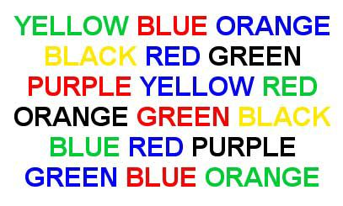
The Stroop Test
Read the words below OUT LOUD as fast as you can

Slide 13
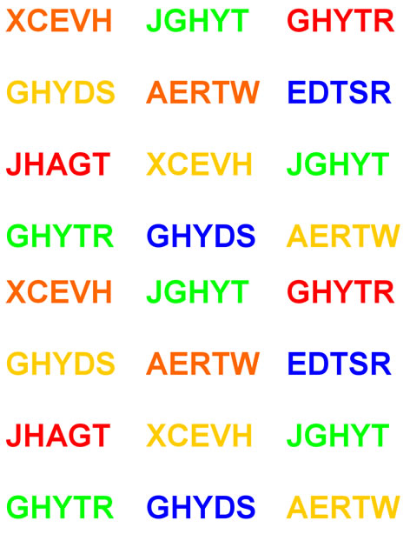
The Stroop Test
Say the COLOR of each nonsense word to the right as fast as you can.

Slide 14
The Stroop Test
Read the COLOR of each word below as fast as you can

Slide 15
Selective Attention and the Stroop Test
Stroop Test
Why is this task so difficult to do
reading is an automatic process
color naming is a controlled process
automatic process of reading interferes with our ability to selectively attend to ink color

Slide 16
Who Committed The Crime?
http://www.youtube.com/watch?v=ubNF9QNEQLA&feature=related

Slide 17
Change Blindness
http://www.youtube.com/watch?v=vBPG_OBgTWg
This is another form of inattentional blindness
When focusing on one thing, we often are not as aware of the other things in our environment

Slide 19
DAY 2
Need smelly markers & book/envelope with quarter

Slide 20
Thresholds
Threshold
THRESHOLDS are NOT fixed! They may vary depending on the person, environment, etc.
Absolute threshold

Slide 21
Thresholds Demo
Walk closer/farther from the timer until you can just barely hear it. (One more step backwards and you can’t hear it)
Adjust as necessary. Does it get easier/harder with time passing?

Slide 22
EXAMPLES OF ABSOLUTE THRESHOLDS
Vision: The amount of light present if someone held up a single candle 30 mi (48 km) away from us, if our eyes were used to the dark. If a person in front of you held up a candle and began backing up at the rate of one foot (30 cm) per second, that person would have to back up for 44 hours before the flame became invisible.
Hearing :The ticking of a watch in a quiet environment at 20 ft (6 m).
Taste: One drop on quinine sulfate (a bitter substance) in 250 gal (946 l) of water. Quinine is one of the components of tonic water.
Smell: One drop of perfume in a six-room house. This value will change depending on the type of substance we are smelling.
Touch: The force exerted by dropping the wing of a bee onto your cheek from a distance of one centimeter (0.5 in). This value will vary considerably depending on the part of the body involved.

Slide 23
Signal Detection Theory
 | Response Yes | Response No
Signal Present | Hit | Miss
Signal Absent | False Alarm | Correct Negative

Slide 24
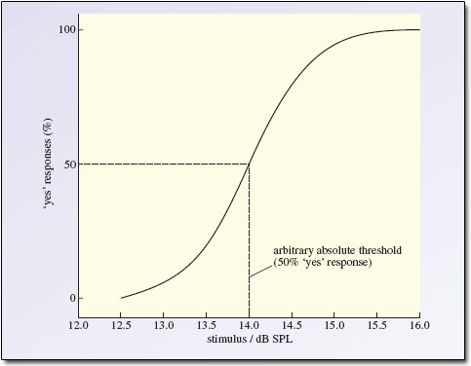

Slide 25
Weber’s Law
For a difference to be perceptible, two stimuli must differ by a different PROPORTION, not a different AMOUNT
Just-Noticeable Difference – The minimum change in stimuli needed to notice a difference 50% of the time
Demonstration

Slide 26
Subliminal Stimuli
Doesn’t exceed the threshold
Can have a BRIEF effect through PRIMING
Ex: reading a list of words about rudeness and then interrupting a person giving a task
Does NOT have a long-term effect
Body Wisdom

Slide 27
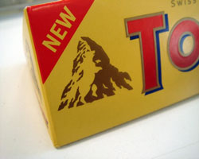
Subliminal Stimuli

Slide 28
Sensory Adaptation
As your senses become used to a stimulus, you no longer notice it.
Demonstration:
1. Smell the marker, notice the strength of the scent. Rate it from 1-20
2. Sniff quickly and repeatedly. After each sniff, rate the strength of the scent from 1-20. What happens?
3. Sniff to aptation (no longer noticing the smell) then quickly switch with your partner. What happens?
Cross-adaptation? (smell nothing)
Smell new stimulus?
Facilitation? (new stimulus is more intense)

Slide 29
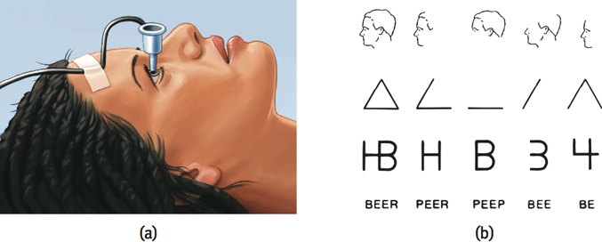
Sensory Adaptation

Slide 30
Synesthesia
http://www.youtube.com/watch?v=KApieSGlyBk

Slide 33
Day 3 QUICK OVERVIEW
Now is the time to ask questions!

Slide 34
Sensation & Perception
Vision & Hearing

Slide 35
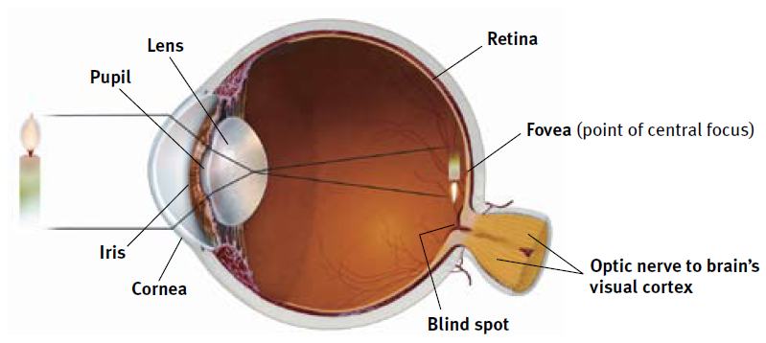
The Structure of the Eye
Fovea, Optic Nerve, & Blind Spot

Slide 36
The Eye The Retina
Optic nerve
Blind spot
Fovea

Slide 37
Blind Spot

Slide 38
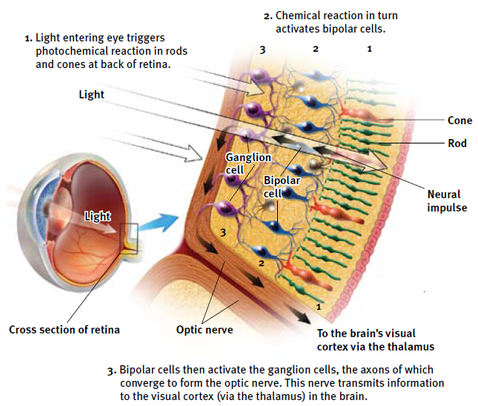
The Retina’s Reaction to Light & Transduction

Slide 39
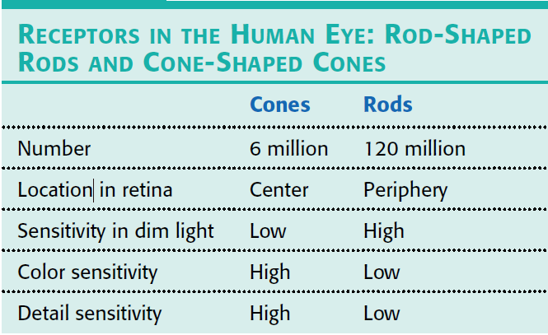
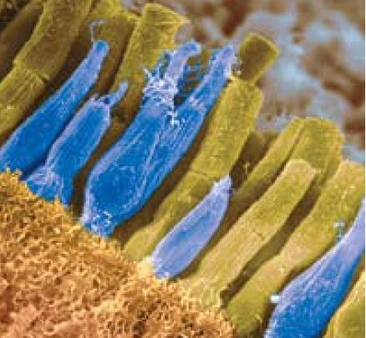
Rods versus Cones

Slide 40
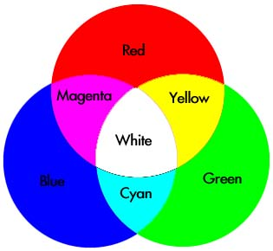
Color Vision
Scientists are not 100% clear about this process
Current Thinking
Step 1: Trichromatic Theory
Cones for red, green, and blue light
People who are color blind are missing one or more of these receptors (usually red)
Step 2: Opponent-Process Theory
Some neurons are turned “on” by a color, some are turned “off”
Opponent colors: red-green, yellow-blue, white-black

Slide 41
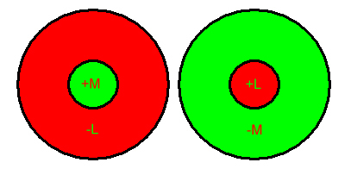
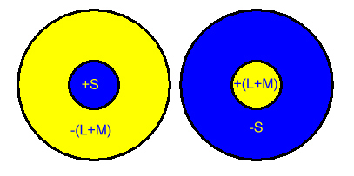
Opponent-Process Theory

Slide 42
Color Blindness
Not a complete lack of color vision
Usually affects red/green the most
Most common in males
Genetic

Slide 43
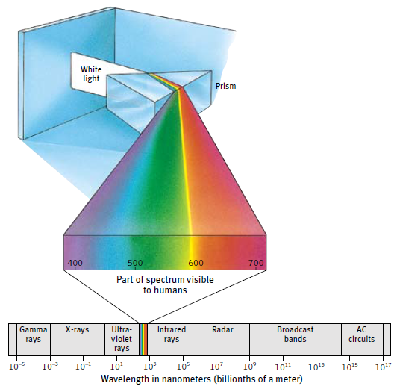
Electromagnetic Energy Spectrum

Slide 44
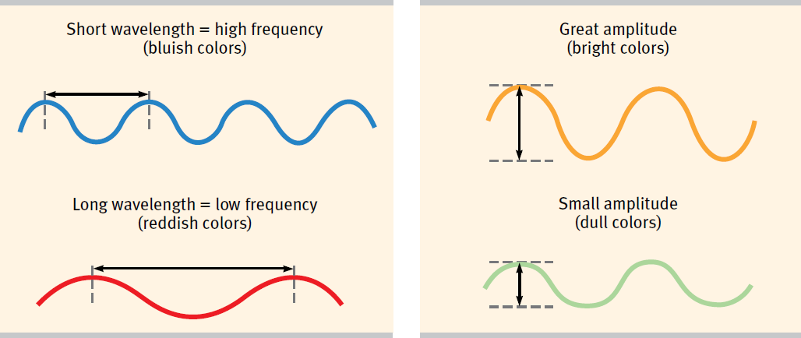
The Physical Property of Waves

Slide 45
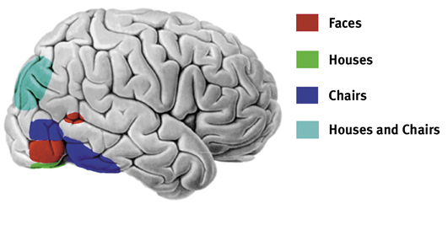
Visual Information Processing Feature Detection
Feature detectors

Slide 46
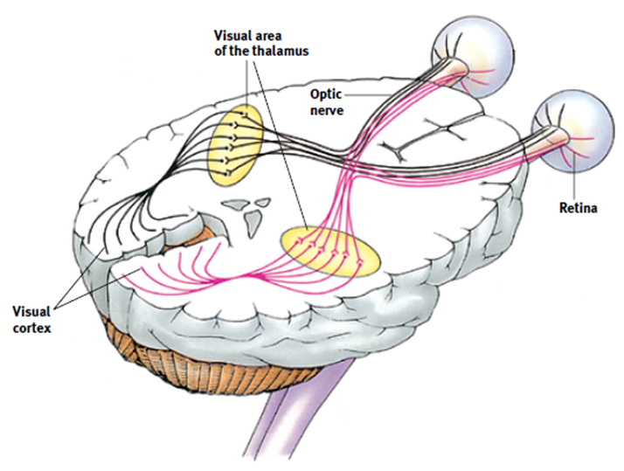
Pathways from the eyes to the visual cortex

Slide 47
Color & Label These Structures in the Eye
Cones, Rods, Bipolar Cells, Ganglion Cells

Slide 48
The Retina’s Reaction to Light & Transduction

Slide 49
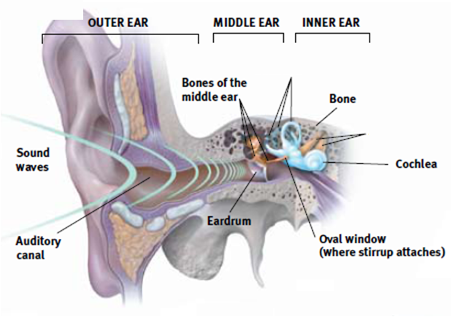
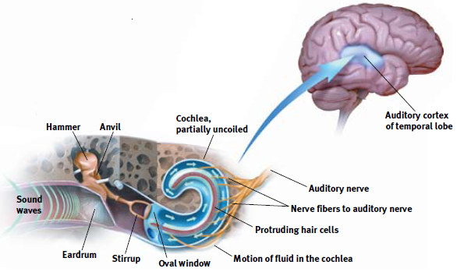
Neural impulse to the brain

Slide 50
The Ear Perceiving Pitch
Place theory
High pitched sounds
Frequency theory
Low pitched sounds

Slide 51
Place theory
= in hearing, the theory that links the pitch we hear with the place where the cochlea’s membrane is stimulated.

Slide 52
Frequency theory
= in hearing, the theory that the rate of nerve impulses traveling up the auditory nerve matches the frequency of a tone, thus enabling us to sense its pitch.

Slide 53
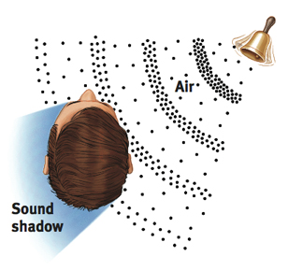
The Ear Locating Sounds
Stereophonic hearing
Localization of sounds
Intensity
Speed of the sound

Slide 54
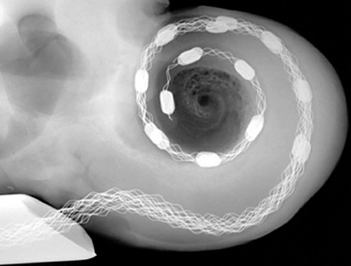
Hearing Loss and Deaf Culture
Hearing loss
Conduction hearing loss - Problems with the eardrum or three bones of the middle ear.
Sensorineural hearing loss - hearing loss caused by damage to the cochlea’s receptor cells or to the auditory nerves; also called nerve deafness.
Cochlea implant

Slide 56
Sensory Interaction
Unwrap your Starburst candies and put them in the cup. Do NOT eat them yet.
Close your eyes and plug your nose. Randomly pick a candy and put it in your mouth and chew. What flavor is it?
Now unplug your nose (still without looking at the candy). What flavor is it?
Look at the color of the candy. Were you right in your guesses? (Feel free to try this again!)
Taste & Smell Interact

Slide 57
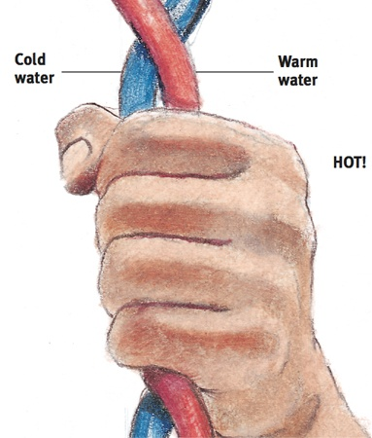
Touch
Types of touch
Pressure
Warmth
Cold
Pain
Sensation of hot

Slide 58
Touch
Touch your two index fingers together. Where do you feel the sensation? Left finger, right finger, or both equally?
Touch your bottom lip with your index finger. Where do you feel the sensation? Index finger, lip, or both equally?
Touch your shoulder with your index finger. Where do you feel the sensation? Index finger, shoulder, or both equally.

Slide 59
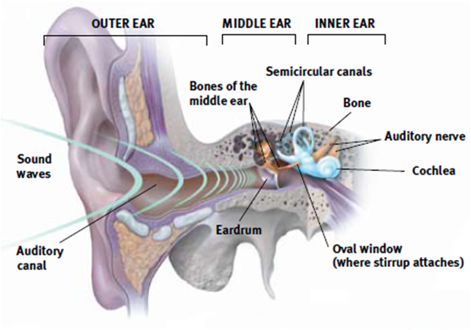
Touch
Kinesthesis
Vestibular sense
Semicircular canals
Nystagmus (spinning)

Slide 60
Sensory Interaction
Stand on one foot for 30 seconds.
Now, close your eyes and stand on one foot for 30 seconds
Now, spin in a circle 5 times, close your eyes, and stand on one foot for 30 seconds.
Vision, Kinesthesis, and Vestibular Sense Interact

Slide 61
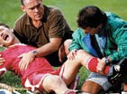
Pain Understanding Pain
Biological Influences
Noiceptors
Sensory receptors that detect hurtful temperature, pressure, or chemicals
Gate-control theory
Endorphins
Phantom limb sensations
Tinnitus

Slide 62
Gate-control theory
= the theory that the spinal cord contains a neurological “gate” that blocks pain signals or allows them to pass on to the brain. The “gate” is opened by the activity of pain signals traveling up small nerve fibers and is closed by activity in larger fibers or by information coming from the brain.

Slide 63
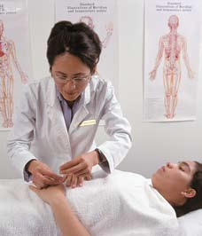
Pain Controlling Pain
Physical methods
Psychological methods

Slide 64
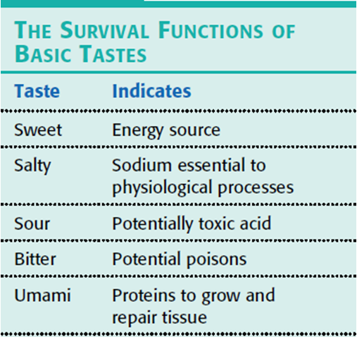
Taste
Sweet, sour, salty and bitter
Umami
Taste buds
Chemical sense
Age and taste

Slide 65
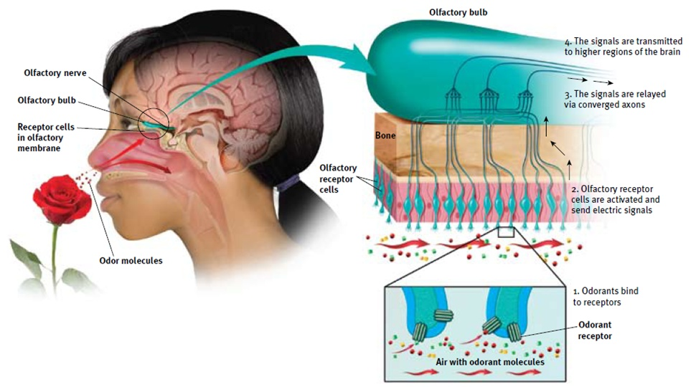
Smell (olfaction)

Slide 66
Felt Boards – Eye/Ear Review
With ONE other person (or on your own) grab a felt board (there are 12).
Send ONE person to grab a baggie. Two are labeling the eye/ear and two are matching terms & definitions. Use a textbook or notes if necessary.
When you are done, call me over to check it. You can grab and begin another baggie while you wait.
You should complete four baggies – label the ear, label the eye, eye terms & definitions, ear terms & definitions.
If you finish early you can grab colored pencils and use the eye/ear color sheet to review (like we did with the brain).
There WILL be a brief quiz that you need to complete independently so be sure you understand the location & function of the eye/ear parts!

