Slide 1
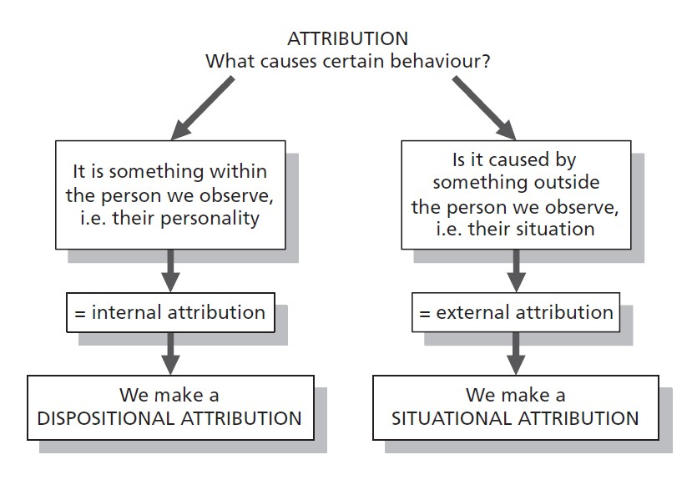

Slide 2
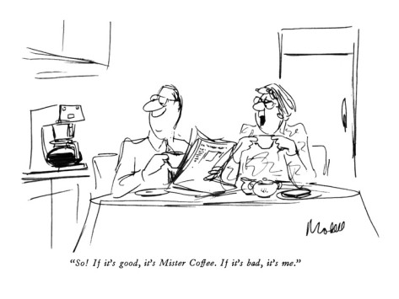

Slide 4
Fundamental Attribution Error
When judging the actions of others, we overestimate disposition, underestimate situation

Slide 5
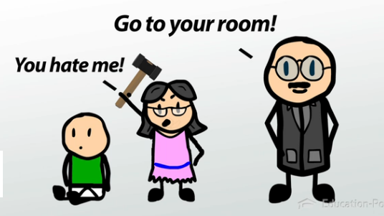
Actor-Observer Bias
We are more likely to attribute our own actions to the situation, and other’s actions to their dispositions.

Slide 6
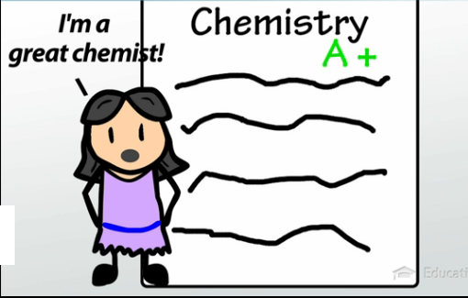
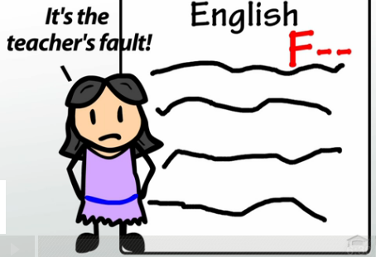
Self-Serving Bias
We make a dispositional attribution for our positive actions, and a situational attribution for our negative actions.

Slide 7
 | Attributions for own actions | Attributions for others’ actions
Self-Serving Bias
Actor-Observer Bias
Fundamental Attribution Error

Slide 8
Fundamental Attribution Error
When judging the actions of OTHERS, what type of attributions do we make?
 | Dispositional Attribution | Situational Attribution
Positive Actions
Negative Actions
Give some examples:

Slide 9
Self-Serving Bias
When judging the actions of OURSELVES, what type of attributions do we make?
 | Dispositional Attribution | Situational Attribution
Positive Actions
Negative Actions
Give some examples:

Slide 10
Actor-Observer Bias
When judging the actions of OTHERS, what type of attributions do we make?
 | Dispositional Attribution | Situational Attribution
Positive Actions
Negative Actions
When judging OUR OWN actions, what type of attributions do we make?
 | Dispositional Attribution | Situational Attribution
Positive Actions
Negative Actions
Give some examples:

Slide 11
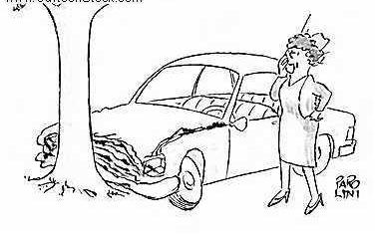
What is the likely attribution?

Slide 12
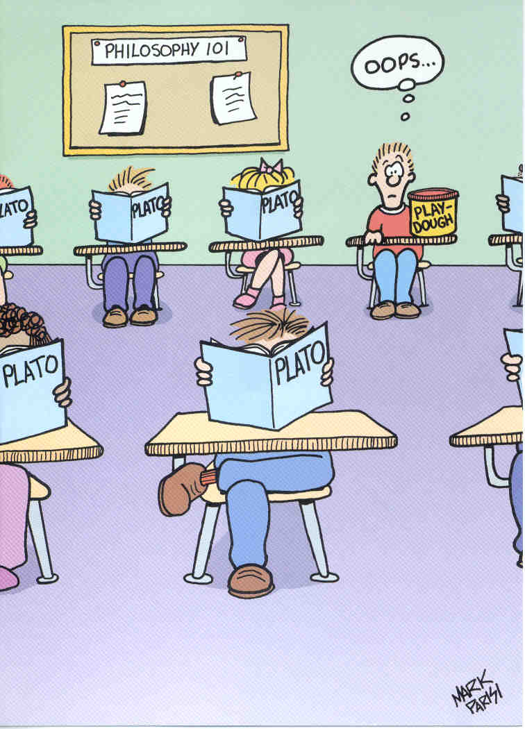
What is the likely attribution if you are: The student? His classmates? His teacher? What bias explains this?

Slide 13
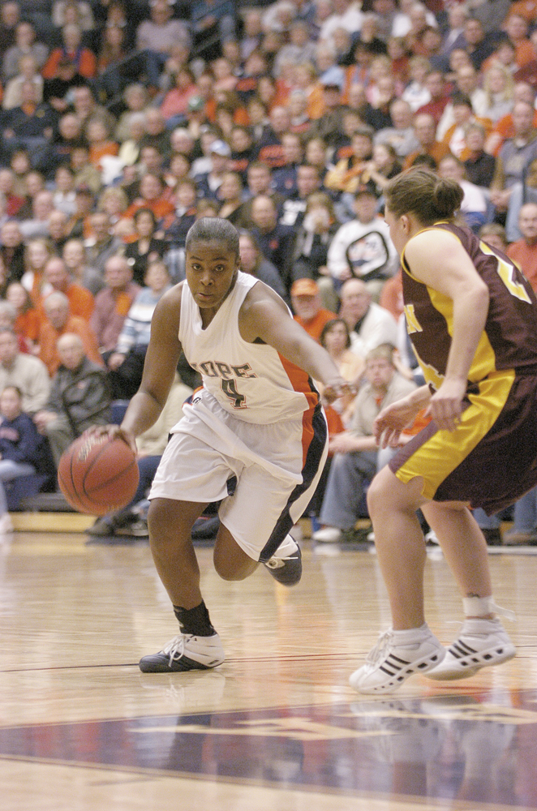
Group Influence Individual Behavior in the Presence of Others
Social Facilitation
Social Inhibition
Task difficulty
Expertise effects
Crowding effects

Slide 14
Group Influence Individual Behavior in the Presence of Others
Social Loafing
Reasons why?
Less accountability
View themselves as dispensable

Slide 15
Group Influence Individual Behavior in the Presence of Others
Deindividuation

Slide 16
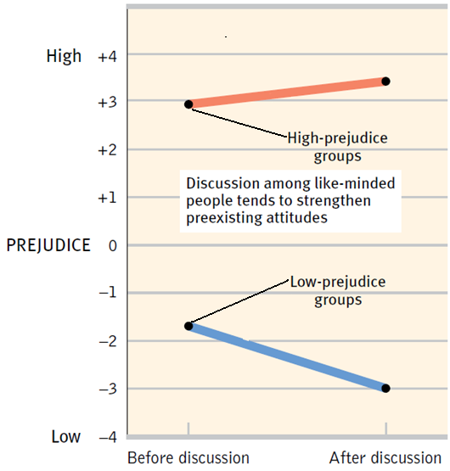
Group Influence Effects of Group Interaction
Group Polarization

Slide 17
Group Influence Effects of Group Interaction
Groupthink
Bay of Pigs
Challenger explosion

