Slide 1
Do Now: Take out your HW & Work on your Level-Up Quizzes

Slide 2
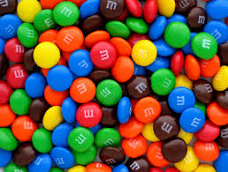
M&Ms Statistics
You have been given a “random sample” of M&Ms from the “population” of all M&Ms.
Open your package and complete your chart. DO NOT eat your M&Ms yet as this will interfere with your sample and invalidate your results.

Slide 3
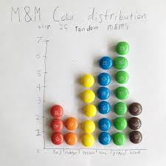
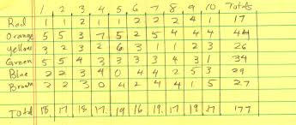
M&Ms Statistics
Based on your results, what would you expect the color distribution of M&Ms to be in a typical bag of M&Ms?
Now, form a group of 4-6 students, and re-calculate your distributions based on your combined sample. What happens with your results?

Slide 4
M&Ms Distribution
For the last few years I have not been able to find accurate distributions on the Mars website.
Here is the most accurate info I could find:
As of 2008, a book cites these numbers:
Blue – 24%
Orange – 20%
Green – 16%
Yellow – 14%
Brown – 13%
Red – 13%
I also found a site that claimed the distribution was even (20% for each color)

Slide 5
Conclusions about Samples
(Last Question on WKST)
Based on this exercise, what conclusions can you draw about generalizing results from a sample?

Slide 6
M&Ms Statistics
Now, imagine that you are testing the statement “M&Ms melt in your mouth but not in your hand.”
Answer the questions on your wkst with a partner.

Slide 7
M&Ms Statistics
Random Selection, Random Assignment, and Representative Sample
Apply these terms to the M&Ms study you have described.

Slide 8
Making Inferences When Is an Observed Difference Reliable?
Representative samples are better than biased samples
Less-variable observations are more reliable than those that are more variable
More cases are better than fewer

Slide 9
Making Inferences When Is a Difference Significant?
Statistical significance
The averages are reliable
The differences between averages is relatively large
Does imply the importance of the results

Slide 10
Statistical Significance
= a statistical statement of how likely it is that an obtained result occurred by chance.
Represented by a p-value. The p-value is a statistical measure that tells how likely it is that the results were due to chance.
Researchers need a p-value that is less than .05 to consider their results statistically significant.

