Slide 1
Do Now
Complete a level-up quiz. If you finish early, study for your next quiz.
Questions about hindsight bias or overconfidence?

Slide 2
Research Methods Theory vs. Hypothesis
Theory: An explanation of events or behaviors based on a series of observations OR scientific findings.
Can start based on observations and becomes more and more scientifically solid based on research and replication
Hypothesis: A testable prediction. Often used to TEST a theory.

Slide 3
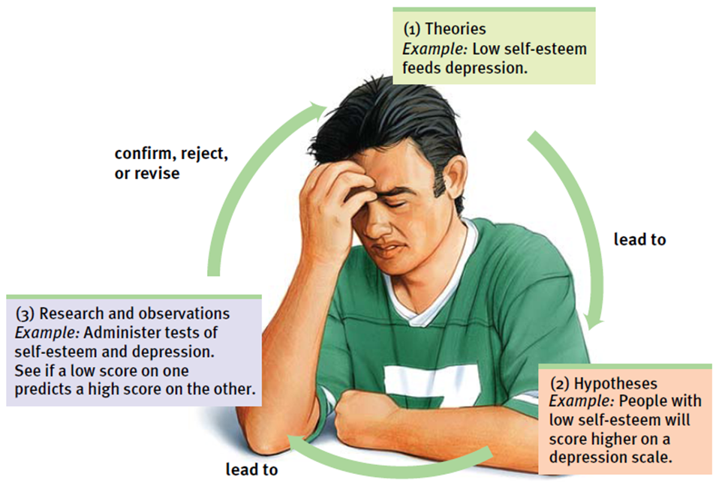

Slide 4
Operational Definitions
A clear definition of key variables in a research study. This helps others understand and replicate the procedures used in a study.
EX: Low self-esteem leads to increased depression.
What terms would we need to OD?

Slide 5
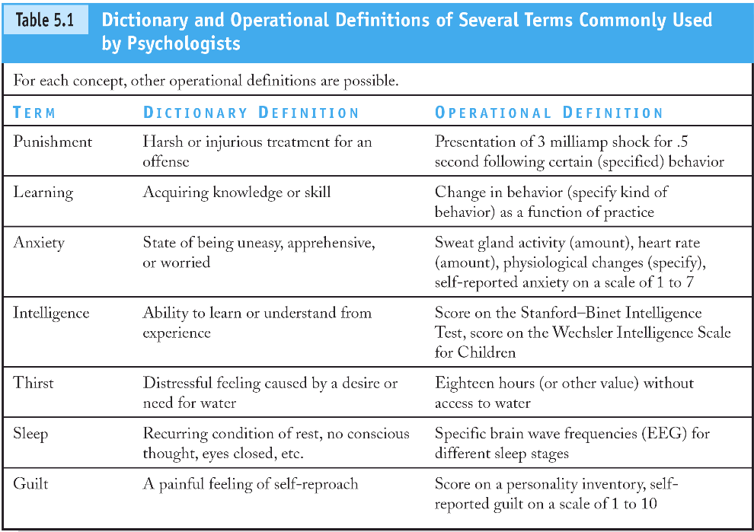

Slide 6
In the following hypotheses, determine what terms need an operational definition. Then, write an operational definition for each term you identified.
Athletes who weigh more run slower than athletes who are lighter.
2. Studying improves academic performance.
3. People who consume caffeinated beverages in the morning have faster reaction times.

Slide 7
M&Ms Study
Video – 80s commercial
Think about the “theory” proposed by the M&Ms commercial. How could we test this?
On your handout, create your hypothesis and operationally define key terms/variables.

Slide 8
Sample & Population
Population: ALL people/cases in a group being studied
Random Sample: Selecting a small group from the larger population. Random = all participants have an EQUAL chance of being selected.

Slide 9
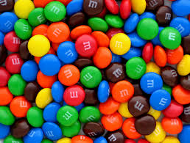
M&Ms Statistics
You have been given a “random sample” of M&Ms from the “population” of all M&Ms.
Open your package and complete your chart. DO NOT eat your M&Ms yet as this will interfere with your sample and invalidate your results.

Slide 10
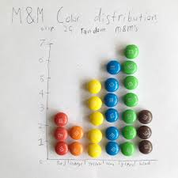
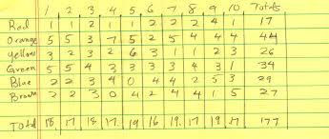
M&Ms Statistics
Based on your results, what would you expect the color distribution of M&Ms to be in a typical bag of M&Ms?
Now, form a group of 4-6 students, and re-calculate your distributions based on your combined sample. What happens with your results?

Slide 11
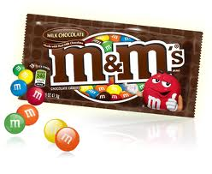
M&Ms Distribution
For the last few years I have not been able to find accurate distributions on the Mars website.
Here is the most accurate info I could find:
As of 2008, a book cites these numbers:
Blue – 24%
Orange – 20%
Green – 16%
Yellow – 14%
Brown – 13%
Red – 13%
I also found a site that claimed the distribution was even.

Slide 12
Day 2

Slide 13
M&Ms Statistics
Based on your results, what would you expect the color distribution of M&Ms to be in a typical bag of M&Ms?
Now, form a group of 4-6 students, and re-calculate your distributions based on your combined sample. What happens with your results?

Slide 14
M&Ms Distribution
For the last few years I have not been able to find accurate distributions on the Mars website.
Here is the most accurate info I could find:
As of 2008, a book cites these numbers:
Blue – 24%
Orange – 20%
Green – 16%
Yellow – 14%
Brown – 13%
Red – 13%
I also found a site that claimed the distribution was even.

Slide 15
M&Ms Statistics
Random Selection, Random Assignment, and Representative Sample
Apply these terms to the M&Ms study you have described.

Slide 16
Making Inferences When Is an Observed Difference Reliable?
Representative samples are better than biased samples
Less-variable observations are more reliable than those that are more variable
More cases are better than fewer

Slide 17
Conclusions about Samples
Based on this exercise, what conclusions can you draw about generalizing results from a sample?

Slide 18
Research Methods
Take out the chart you completed for HW
As I quickly review each method, add to your notes
Be prepared to share out your own examples.
ALSO think about the hypothesis you wrote yesterday related to the M&M’s statement: “Melts in your mouth but not in your hand.”
What would it look like to use each of these methods to test this hypothesis?

Slide 19
Description The Case Study
Case Study
Pros:
Can examine one subject or situation in depth
Useful when manipulating the situation is unethical (ex: Phineas Gage)
Suggest further study
Cons:
Case specific - Cannot discern generalizable truths
The event may/may not happen again so it can be hard to create accurate theories

Slide 20
Description The Survey
Survey
Pros:
Looks at many cases at once
Often fast to administer and score
Cons:
- Word effects
- Subjects can lie
- Sample may not be representative of the population

Slide 21
Day 3

Slide 22
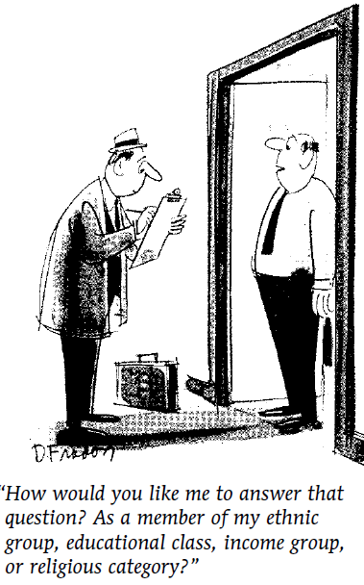
Description The Survey
Sampling
Population
Random Sample
Example – average grades
at KSJC
What happens if we use
AP Psych class?
STRATIFIED Random Sample

Slide 23
Description Naturalistic Observation
Naturalistic Observation
Pros:
See subject in natural environment
Cons:
Need to make inferences based on observations
Can’t control the environment
May not be generalizable

Slide 24
Studying Development
Longitudinal Study – Study the same group over time
Pros: Limit confounding variables due to differences in participants (generational variables)
Cons: Expensive & time consuming, large commitment for participants, loss of participants may create confounding variables
Cross-Sectional Study – Study people of different ages all at one time
Pros: Shorter & cheaper – less participant loss
Cons: Confounding variables (Generational, etc.)

Slide 25
Correlation Studies (More to Come!)
Examine the relationship between two or more variables
Pros:
- Can determine if there is a relationship between two things (ex – tv watching & violence)
- Can come from already existing data, surveys, observations, etc.
Cons:
- Can NOT determine which variable is the cause!
Surveys, Naturalistic Observations, and Case Studies
are ALL correlational studies!!

Slide 26
Experimentation
Experiment
Pros:
Can determine cause and effect
Cons:
Hard to control for EVERY variable
Difficult to apply lab results to the real world
Control of factors
Manipulation of the factor(s) of interest
Hold constant (“controlling”) factors

Slide 27
Back to the M&Ms!
We have decided that an EXPERIMENT is the best way to study our M&Ms hypothesis.
Take out your M&Ms packet (and keep out your homework wkst). As we review key experimental terms, we will be applying them to our study.
We will start with our variables!

Slide 28
Experiment: Key Terms
Independent Variable (IV) = the experimental factor that is manipulated; the variable whose effect is being studied.
Dependent Variable (DV) = the outcome factor; the variable that may change in response to manipulations of the independent variable.
Confounding Variable= a factor other than the independent variable that might produce an effect in an experiment.

Slide 29
M&Ms Variables
Identify the IV, DV, and Confounding Variables in your M&Ms Experiment.
When you finish, you can begin answering the questions under “Reviewing Sampling Procedures”

Slide 30
Confounding Variables & Sampling Errors
A political campaign wants to poll potential voters to see how they feel about a candidate. They place calls to homes between the hours of 8:00-10:00am.
The mayor wants input from the community on the planned festivities for the upcoming 4th of July celebration. She places a survey of options in the paper and lists the phone number for citizens to respond with their answers.
Mr. Ryan wants to know if giving caffeine to students during class helps improve their performance. On Tuesday, he gives Ms. Harrison’s 4th period Jr. Seminar class coffee during class and then gives a quiz at the end of the lesson. On Thursday again gives a quiz at the end of Ms. Harrison’s 4th period class, but this time does not give coffee. He looks at the results and determines that coffee does not impact student performance.

Slide 31
Time to Practice!
Take out the WKST from Tue that we did not complete in class. Start with the 2nd page “Thinking Carefully About Experiments”
With a partner, answer the questions about confounding variables, then answer 1-3
DO NOT Work on 4-9 on the back!
When you are done, look at the first wkst labeled “Pattern Recognition.” With your partner, read each scenario and determine if the conclusions came from a correlation or an experiment.
Quiz Friday on Research Terms (& Stats?)

Slide 32
Day 4

Slide 33
The Simpsons – Bear Patrol
http://www.youtube.com/watch?v=SdBn5G7Y2RA

Slide 34
The Simpsons (Season 7, "Much Apu About Nothing")
Homer: Not a bear in sight. The "Bear Patrol" is working like a charm!
Lisa: That's specious reasoning, Dad.
Homer: [uncomprehendingly] Thanks, honey.
Lisa: By your logic, I could claim that this rock keeps tigers away.
Homer: Hmm. How does it work?
Lisa: It doesn't work; it's just a stupid rock!
Homer: Uh-huh.
Lisa: But I don't see any tigers around, do you?
Homer: (pause) Lisa, I want to buy your rock.

Slide 35
Do Now: Take out your homework from Wed and today and place it on the side (if you are on my HW check list) Follow the directions to log into Exit Ticket and get ready for the quiz When you are done with your quiz and have turned it in, you may get a Chrome Book and work on your Level-Up Quizzes

Slide 36
Correlation vs Experiment

Slide 37
Correlation IS NOT Causation

Slide 38
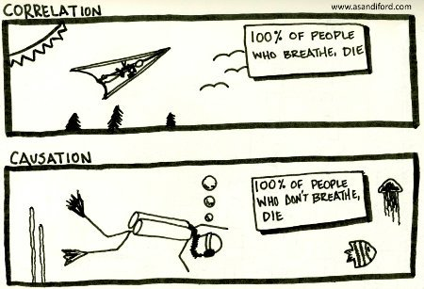

Slide 39
Correlation
= a measure of the extent to which two factors vary together, and thus of how well either factor predicts the other.

Slide 40
Correlation Correlation and Causation
Correlation helps predict
Does not imply cause and effect
For example, depression and self-esteem are negatively correlated, HOWEVER…

Slide 41
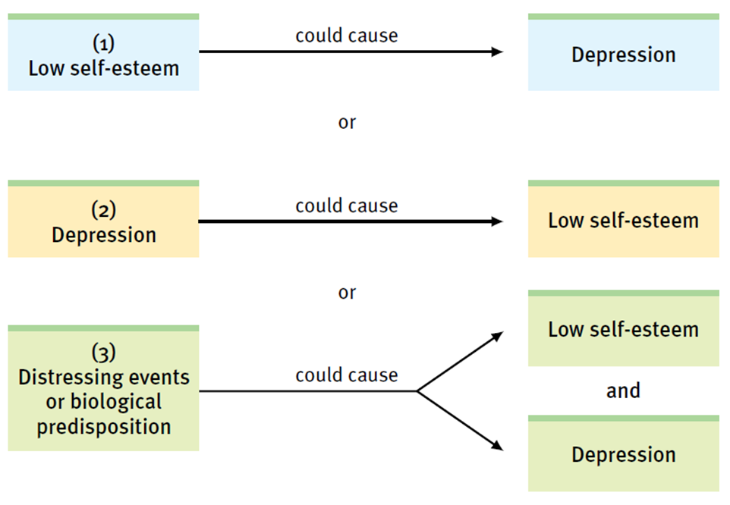

Slide 42
Correlation
Correlation: How well does A predict B
Positive versus negative correlation
Strength of the correlation
-1.0 to +1.0(correlation coefficient)
Scatterplot

Slide 43
Correlation Coefficient
= a statistical index of the relationship between two things (from -1 to +1).

Slide 44
Scatterplot
= a graphed cluster of dots, each of which represents the values of two variables. The slope of the points suggests the direction of the relationship between the two variables. The amount of scatter suggests the strength of the correlation (little scatter indicates high correlation).

Slide 45
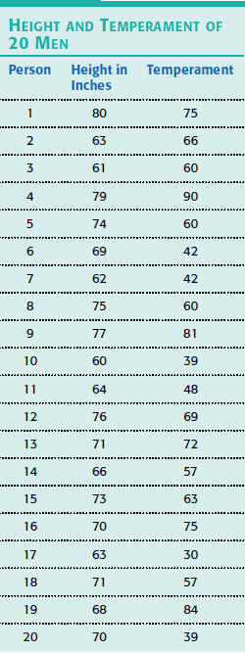
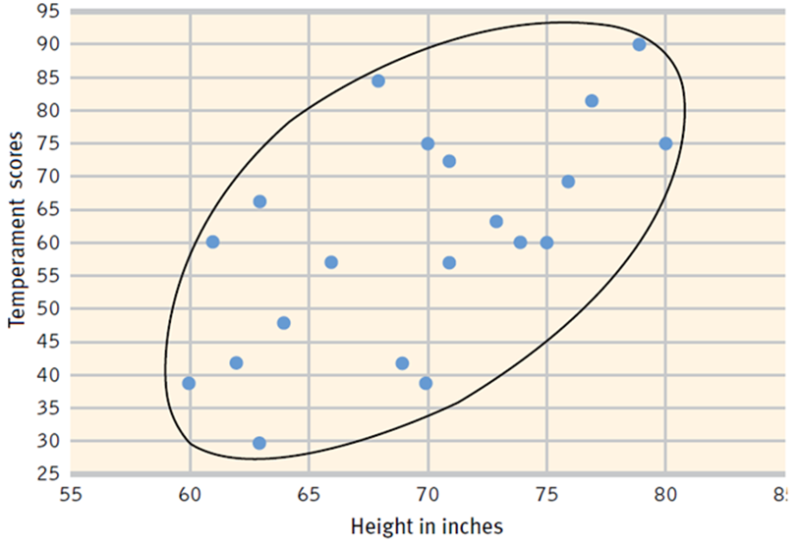
Correlation

Slide 46
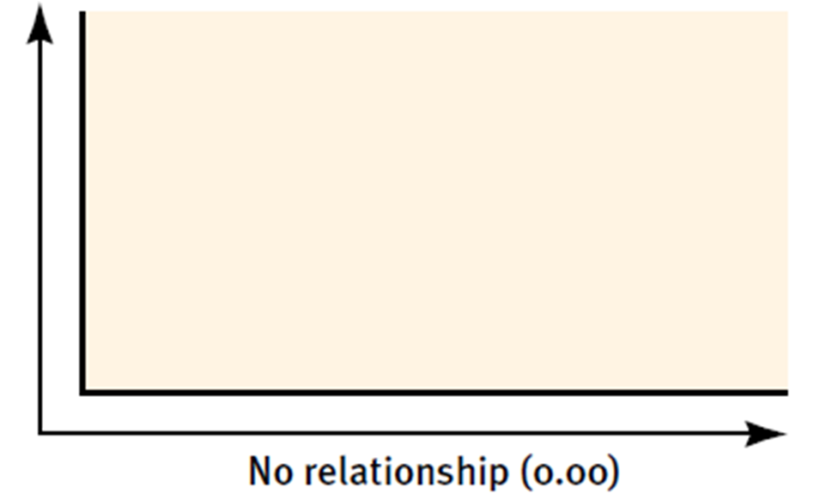
Correlation

Slide 47
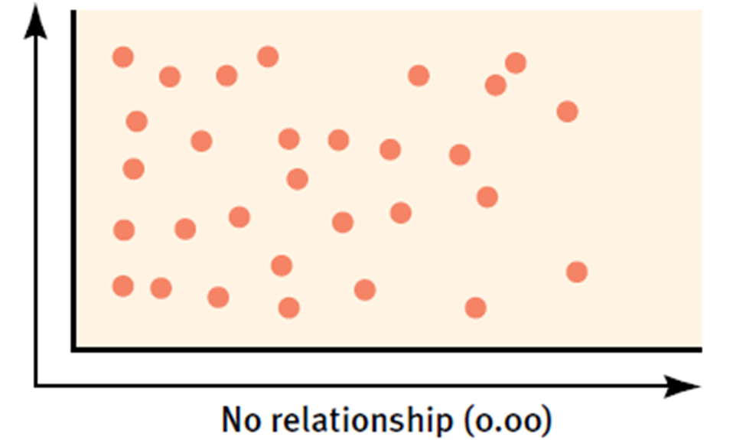
Correlation

Slide 48
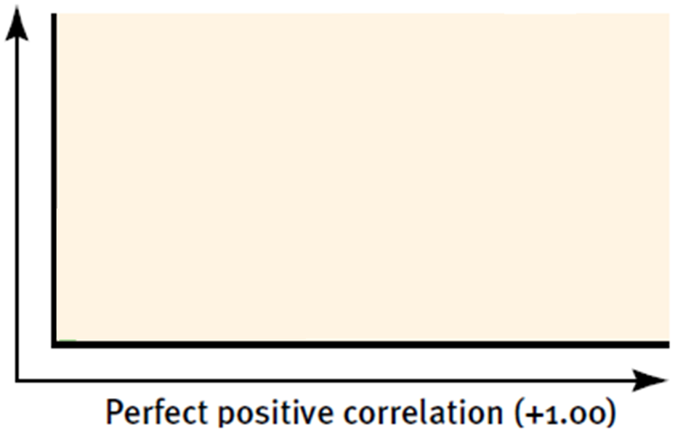
Correlation

Slide 49
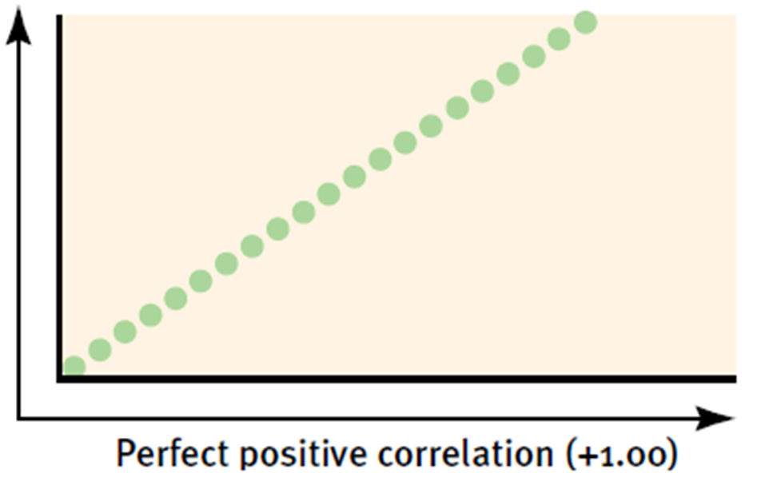
Correlation

Slide 50
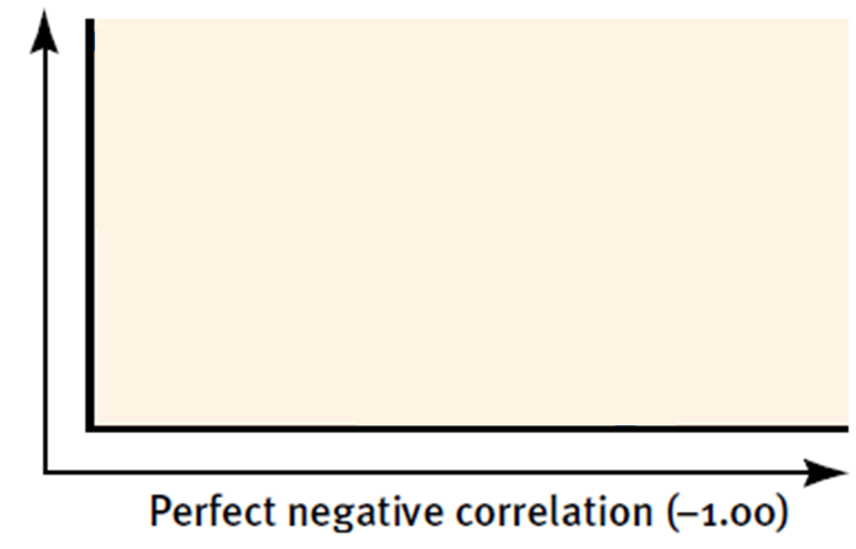
Correlation

Slide 51
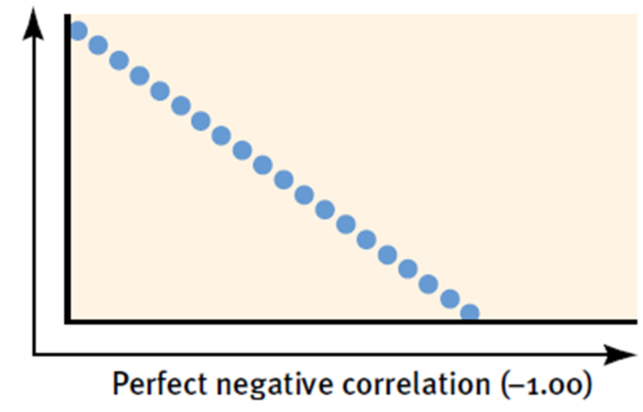
Correlation

Slide 52
Positive, Negative, or No Correlation?

Slide 53
Positive, Negative, or No Correlation?

Slide 54
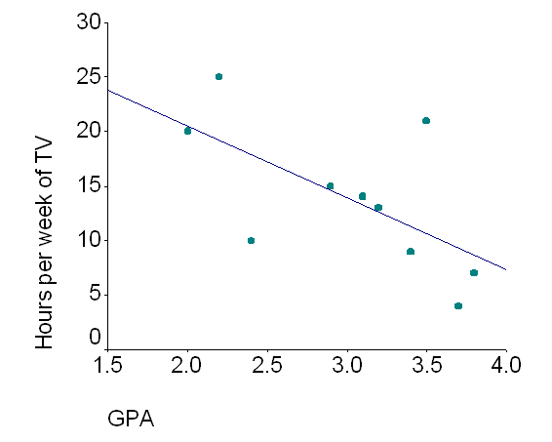
Positive, Negative, or No Correlation?

Slide 55
Positive, Negative, or No Correlation?

Slide 56
Positive, Negative, or No Correlation?
1. As people walk more, they lose weight.
2. As people sleep more, their grades increase.
3. As people study less, their grades decrease.
4. As people smoke less, their health improves.

Slide 57
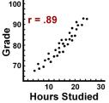
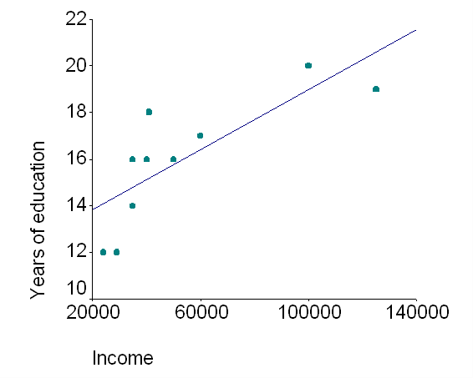
Positive, Negative, or No Correlation? Which Correlation appears strongest?

Slide 58
Which correlation is strongest?
1. +0.2 or +0.02
2. -0.18 or -0.76
3. -0.92 or +0.53
4. +1.0 or +1.5

Slide 59
Drawing Conclusions
If I am told that there is a positive correlation between sleep and grades, what can I conclude? What can I NOT conclude?
If I am told that there is a negative correlation between number of vacation days and stress levels, what does this mean?

Slide 60
Psyc Statistics
Descriptive statistics are used when you are simply describing what is or what the data shows. Measures of central tendency (mean, median, and mode) and variability (range and standard deviation) are both descriptive statistics
With inferential statistics, you are trying to reach conclusions that extend beyond the immediate data alone. For instance, we use inferential statistics to try to infer from the sample data what the population might think. Or, we use inferential statistics to make judgments of the probability that an observed difference between groups is a dependable one or one that might have happened by chance in this study.
In summary, we use inferential statistics to make inferences from our data to more general conditions; we use descriptive statistics simply to describe what's going on in our data.

Slide 61
Describing Data Measures of Central Tendency
Mode (occurs the most)
Mean (arithmetic average)
Median (middle score)

Slide 62
Describing Data Measures of Variability
Range
Standard Deviation

Slide 63
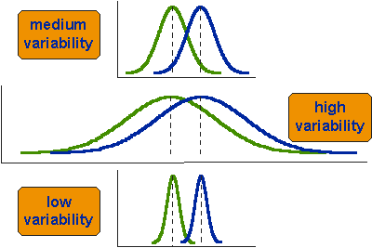

Slide 64
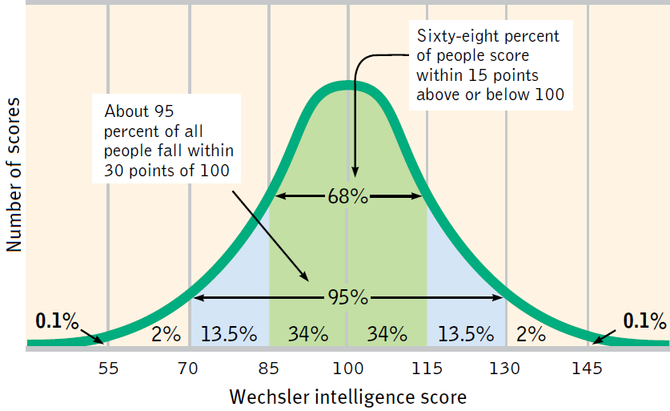
Describing Data Measures of Variability
Normal Curve (bell shaped)

Slide 65
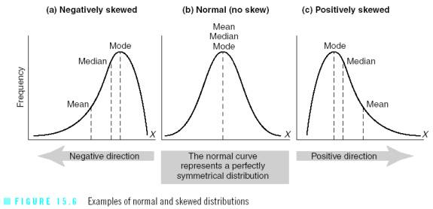

Slide 66
Making Inferences When Is a Difference Significant?
Statistical significance
The averages are reliable
The differences between averages is relatively large
Does imply the importance of the results

Slide 67
Statistical Significance
= a statistical statement of how likely it is that an obtained result occurred by chance.
P-Value – the percent likelihood that a result is due to chance
Want a P-value of 0.05 (5%) or less.
This means we are 95% confident or more that the results are due to manipulating the independent variable (There is a 5% or less likelihood that the results are due to chance)

Slide 68
Practice with Stats
Look at the last page of your M&Ms wkst and answer the questions based on that we just learned.
When you finish, work on the practice statistics questions with a partner. You may use a calculator, but for most questions one is not necessary.

